Slide 1



Camilo Hoffmann Kuschel
Helena Zhang
Henry Lin
Sebastian Rubio
Silvia Sun
Todd Sakawkanokrat

Slide 2
Today’s Agenda
The tasks
Think aloud evaluation study
Heuristic evaluation study
Reflection on the work
Camilo Hoffmann Kuschel
Helena Zhang
Henry Lin
Sebastian Rubio
Silvia Sun
Todd Sakawkanokrat

Slide 3
The tasks
Navigation
Navigate to any chosen section of the book
Go to page 365
Go to Chapter 4 Section 3
Searching
Search any chosen section of the book
Search the term ‘user experience’
Discover how many times the term ‘human-computer’ appears on the book
Notes
Make any note
On page 300 make the note ‘verifying and refining design’
Export the notes as a text file

Slide 4
The tasks
Content
Extraction
Copy any paragraph to the clipboard
Print the preface of the book
Download the whole book as a PDF file
Other
Features
Use any feature that has not been used yet
Have the book to read aloud the page 365
Find the definition of ‘experience’ in the built-in dictionary

Slide 5
Think aloud evaluation
Background
and
Demographics
Users are 18-29 year olds
2 males and 3 females
1 user with high computer literacy
4 with medium
3 are USYD students
Notes:
Overall, the majority of the users are students and are and familiar with computers.

Slide 6

Think aloud evaluation
User 1
Managed to complete all tasks
Quite long time to go through all of them
Previous knowledge of Adobe Reader led to higher expectations from the system
Not intuitive
Did not feel comfortable using it

Slide 7
Think aloud evaluation
User 2
Managed to complete 80% of the tasks
No problem with the abstract tasks
Struggled with some of the concrete ones
Not intuitive
Nor user-friendly

Slide 8
Think aloud evaluation
User 3
Managed to complete all tasks
Some of them pretty quickly
Tried using keyboard shortcuts that did not work
No major problems
The navigation though could be more fluid

Slide 9
Think aloud evaluation
User 4
Managed to complete all tasks
Most of them quite quickly
Had some problems though copying contents and making notes
No major problems
Though the navigation, content copying and note making could be improved

Slide 10
Think aloud evaluation
User 5
Managed to complete all tasks
Had problems with the vertical buttons
Got confused with the way some features are displayed
Not intuitive
Some features do not work it would be expected

Slide 11

Think aloud evaluation
Key
Problems
The page jumping process is not fluid
It is difficult to navigate in the content panel
The search button is vertically aligned
Search results are not highlighted on the pages
Most users try to make notes directly onto the pages
The note making process as a whole is not intuitive
It is really odd not being able to just copy and paste contents
The read aloud feature does allow to select what the user wants
The users find the dictionary feature too simple

Slide 12
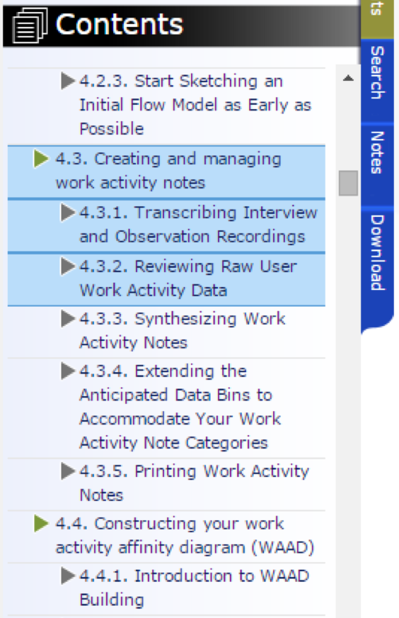
Heuristics evaluation
Problem
Violation
S1
S2
S3
The content panel is not resizable
User control and freedom
4
3
3

Slide 13
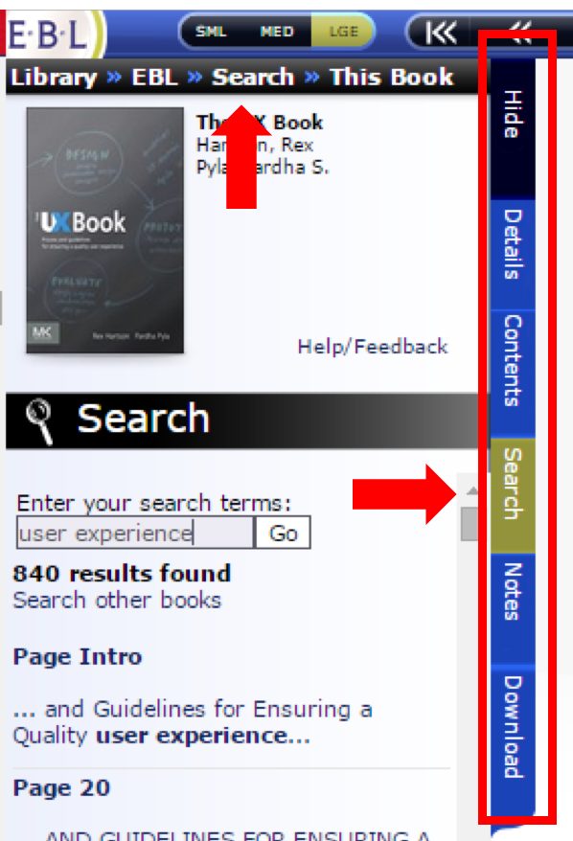
Heuristics evaluation
Problem
Violation
S1
S2
S3
Navigation buttons are placed vertically
Flexibility and efficiency of use
3
2
3
There is no use of icons
Flexibility and efficiency of use
2
1
2
There are two Search options
Error Prevention
4
3
2

Slide 14
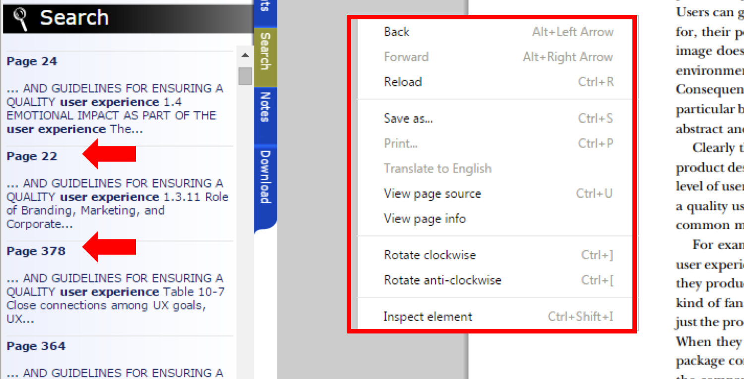
Heuristics evaluation
Problem
Violation
S1
S2
S3
There is no right-click search option
Consistency and standards
2
2
3
No progress indication on page click
Visibility of system status
2
1
2
Results are not ordered by page
Consistency and standards
3
3
3

Slide 15
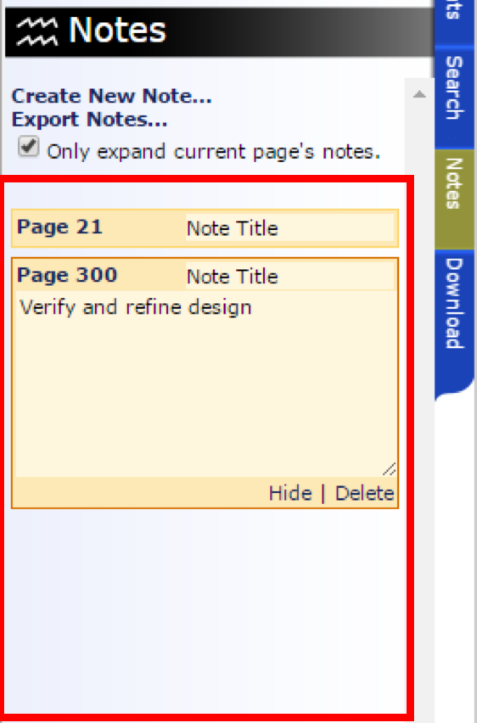
Heuristics evaluation
Problem
Violation
S1
S2
S3
It is difficult to manage notes when
there is already a few of them
Flexibility and efficiency of use
3
3
3

Slide 16
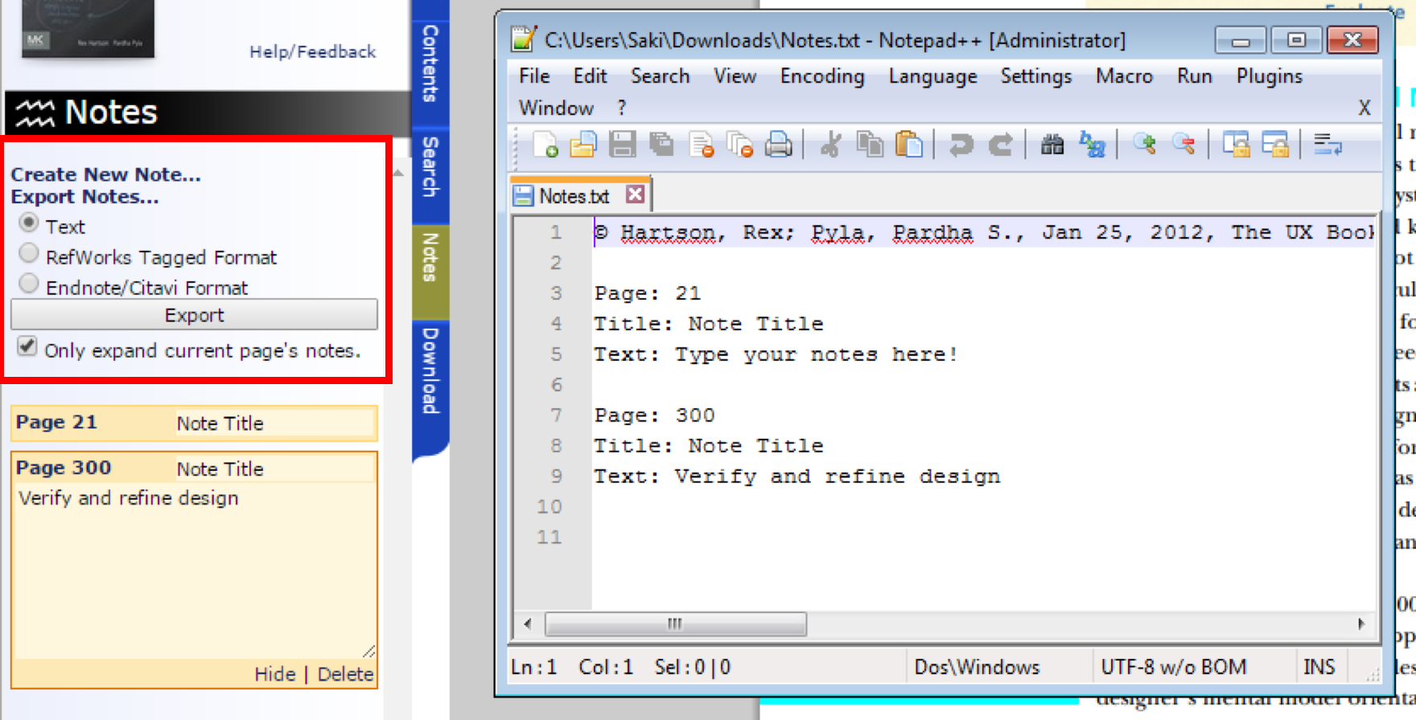
Heuristics evaluation
Problem
Violation
S1
S2
S3
Notes cannot be exported together
with the actual pages
Match between system
and real world
4
3
3

Slide 17
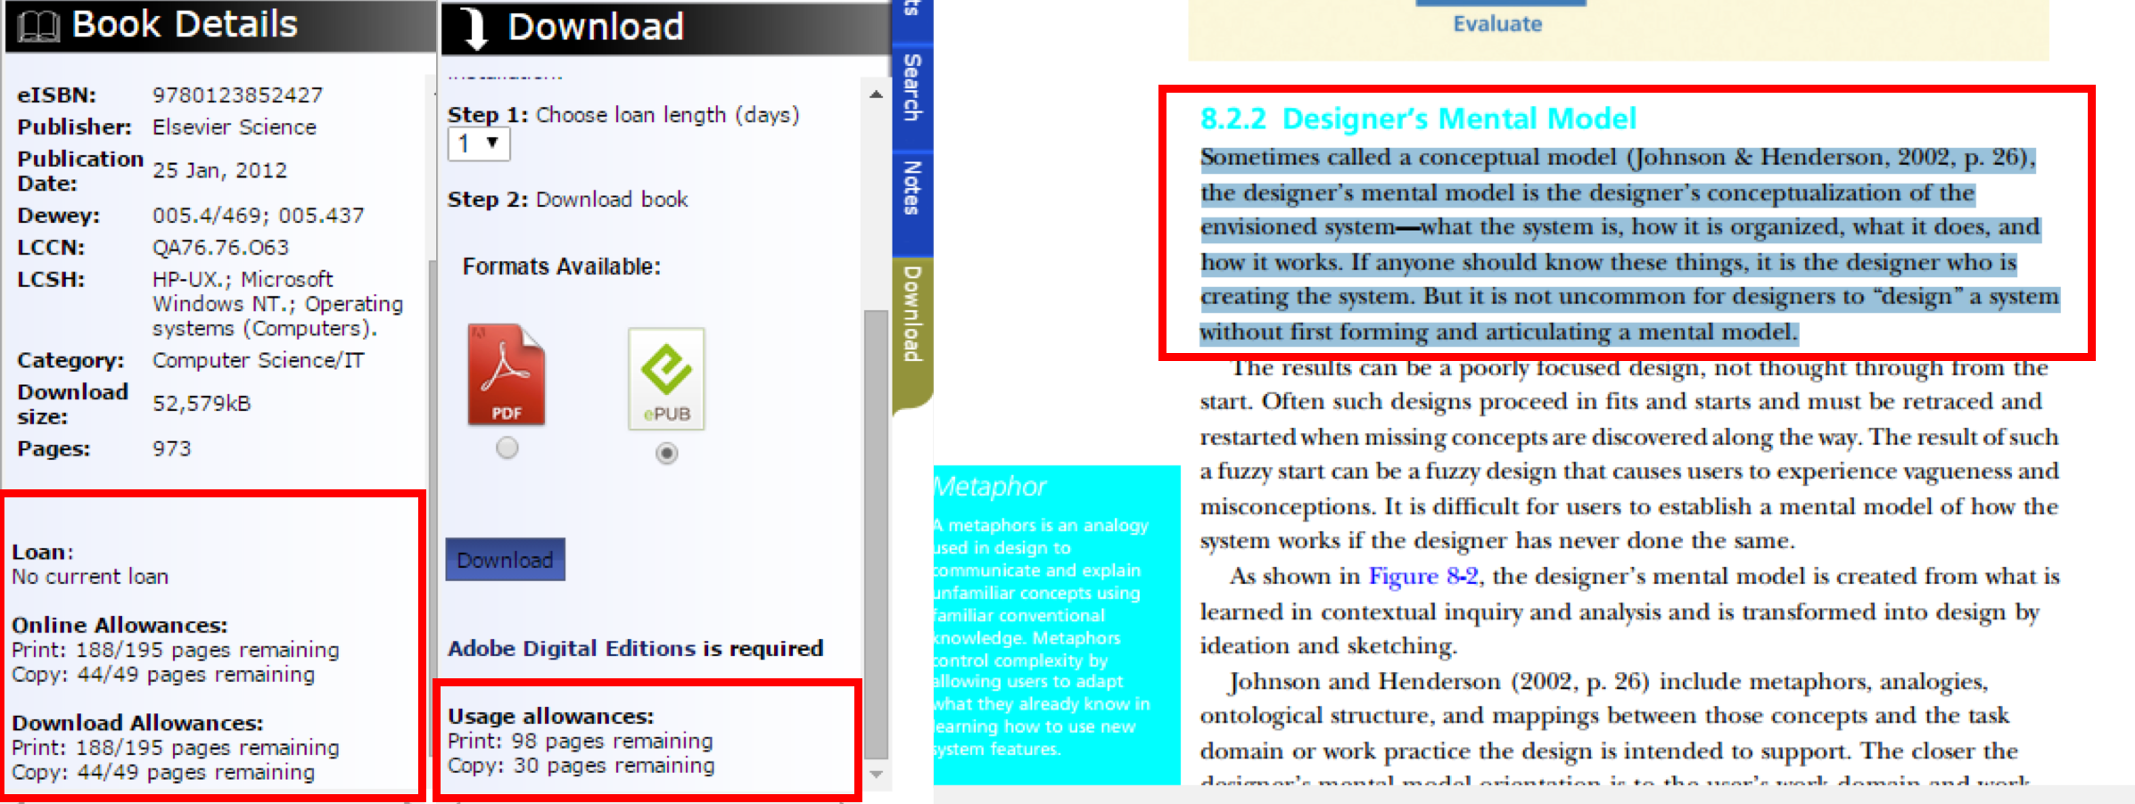
Heuristics evaluation
Problem
Violation
S1
S2
S3
Confusion on the copy/print allowance
Consistency and standards
3
3
3
Confusion when copying/printing
Visibility of system status
3
3
3

Slide 18
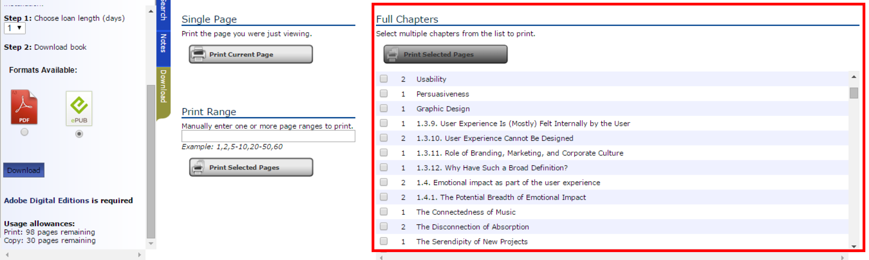
Heuristics evaluation
Problem
Violation
S1
S2
S3
Difficult to navigate in the printing list
Flexibility and efficiency of use
4
3
2
Confusion on the printing allowance
Visibility of system status
2
3
3
Notes:
We are IT people. So, we’re going to identify ‘problems’ that may not be a problem to the other.
We were the ones that designed the tasks. So, we became experts and quite critical on it.

Slide 19
Reflection on the work
Main
Points
Similar experience and feelings
Non expert users just feel frustrated and do not feel like using the system again
Expert users find a workaround
Both non expert and expert users agree the system could be improved
Notes:
Similar experience and feelings: there’s frustration both on TA and HE evaluations.

Slide 20
Reflection on the work
Main
Points
Similar experience and feelings
Non expert users just feel frustrated and do not feel like using the system again
Expert users find a workaround
Both non expert and expert users agree the system could be improved
Thank you.
Notes:
Similar experience and feelings: there’s frustration both on TA and HE evaluations.

